Slide 1
ERTS Final Assessment – Task 1
QINGYU ZHANG and vn22984
SHURAN YANG and rw22242
HAIBO LIAN and tb22111
Group 04

Slide 2
Outline
1) Implementation
Ⅰ. Overall flow chart
Ⅱ. Interrupts
Ⅲ. Polling
2) The movement pattern of the robot
Ⅰ. Autonomous Mode
Ⅱ. Free-motion Mode
3) Video display
4) Questions answer

Slide 3
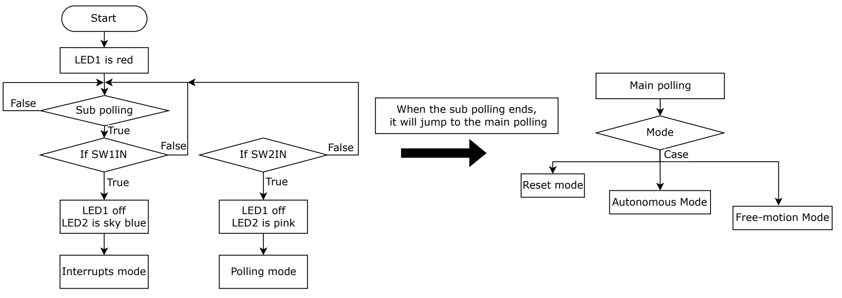
Overall flow chart

Slide 4
Interrupts
1) Interrupts Mode
Ⅰ. Firstly, the LED1 will stay red after the MSP-EXP432P401R LaunchPad Development Kit is powered on.
Ⅱ. Next, press switch 1 to enter interrupts mode.
Ⅲ. After entering interrupt mode, LED2 will turn sky blue and LED1 will be off.
Ⅳ. Interrupt mode contains two modes of robot movement.

Slide 5
Polling
2) Polling Mode
Ⅰ. Firstly, the LED1 will stay red after the MSP-EXP432P401R LaunchPad Development Kit is powered on.
Ⅱ. Next, press switch 1 to enter interrupts mode.
Ⅲ. After entering interrupt mode, LED2 will turn pink and LED1 will be off.
Ⅳ. Polling mode also contains two modes of robot movement.
Ⅴ. However, in polling mode, there is no direct switching between Autonomous mode and Free-motion mode. Therefore, long press switch 1 or switch 2 to toggle.
VI. In addition, the transition between interrupts mode and polling mode needs to press switch reset first.

Slide 6
Practical elements
Show that the robot can move around effectively in both modes of operations
1) Autonomous Mode
Ⅰ. When the switch 1 is pressed, the robot will move forward along a predefined circular route.
Ⅱ. When any bump switch is touched, the robot will stop running immediately.
Ⅲ. In Autonomous mode, the robot can enter Free-motion mode at any time by pressing switch 2. And the robot can stop at any time by pressing switch reset.

Slide 7
2) Free-motion Mode
Ⅰ. When the switch 2 is pressed, the robot will move forward.
Ⅱ. When any bump switch is touched, the robot will move backwards and LED2 will blink green. Meanwhile, for bump switches 1, 2 and 3, the robot will turn left and LED2 will blink yellow. And for bump switches 4, 5 and 6, the robot will turn right and LED2 will blink blue. The closer the bump switch is to the centre, the longer it takes in this process.
Ⅲ. After change direction of movement according to the interrupted bump switches, the robot will continue to move forward.
Ⅳ. In Free-motion mode, the robot can enter Autonomous mode at any time by pressing switch 1. And the robot can stop at any time by pressing switch reset.

Slide 8
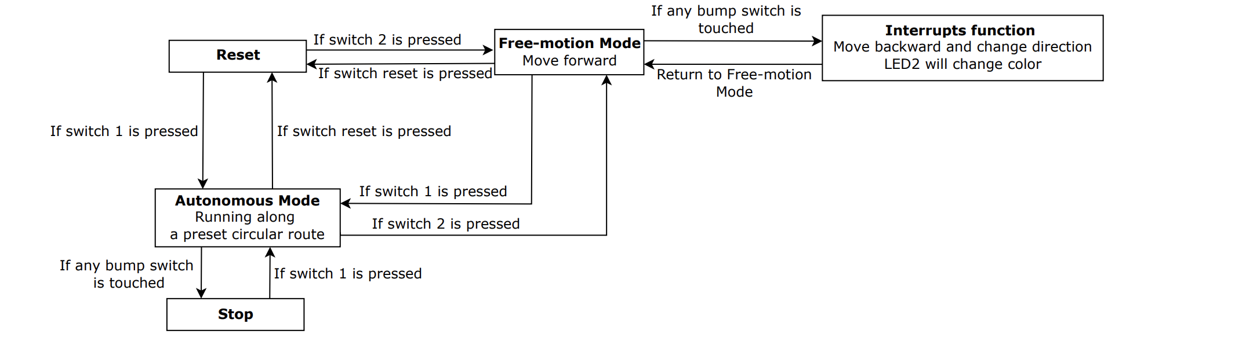
Schematic diagram of operations mode
In polling mode, switching between Autonomous mode and Free-motion mode requires a long press of the switch until the counter reaches 200.

Slide 9
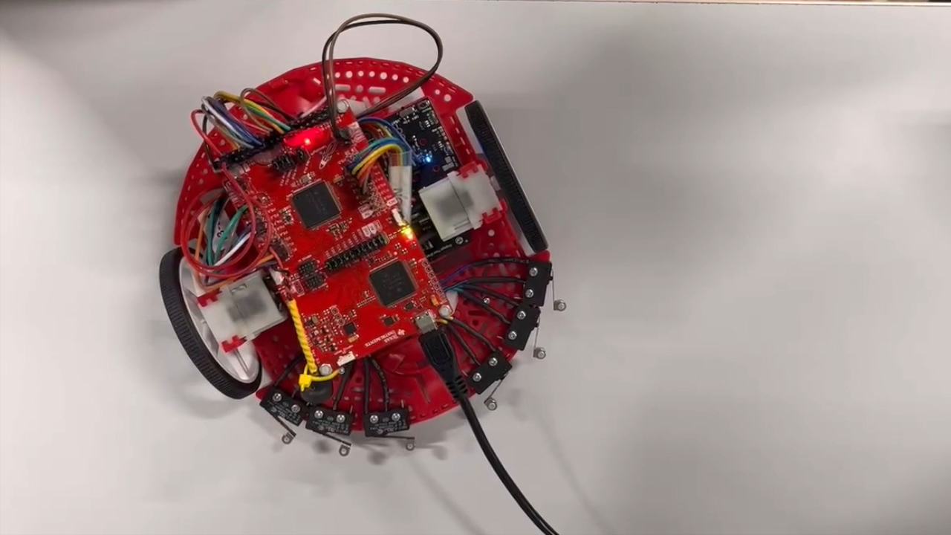
Display of Autonomous Mode and Free-motion Mode (Interrupts)

Slide 10
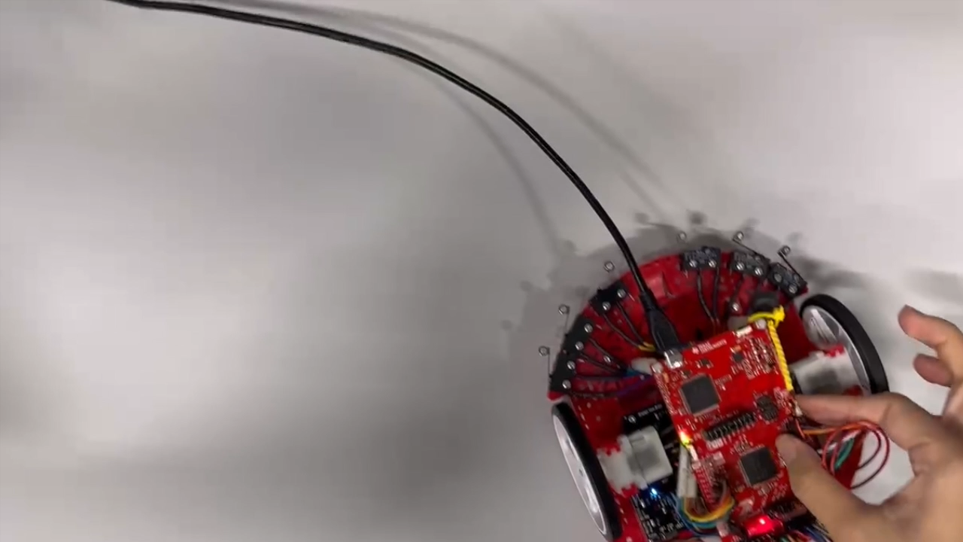
Display of Autonomous Mode and Free-motion Mode (Polling)

Slide 11
Show that we have made use of the LED & Switches
Ⅰ. In the experiment, we used a total of nine switches and two LED lights. Different LED lights will display different colors when different switches are operated.
Ⅱ. The actual changes to the LED lights and switches are demonstrated in the video. The following table shows the relationship between the color change of the LED light and the switching operation.
 | Reset | Switch1 | Switch2 | Bump1 | Bump2 | Bump3 | Bump4 | Bump5 | Bump6
LED1 (Red) | Red
LED2 (Colour) |  | Sky Blue | Pink | Green Yellow | Green Yellow | Green Yellow | Green Blue | Green Blue | Green Blue

Slide 12
Is there nay difference in operation when you robot works in polling mode and interrupt mode?
Interrupt is an external component that alerts the CPU to perform a specific action. And polling is when the CPU constantly checks to determine whether to perform the specific action. Therefore, polling will waste a lot of CPU cycles compared to interrupts. But if interrupts occur frequently in interrupts mode, the efficiency of the CPU will still be reduced.
During the working process of the robot in polling mode and interrupts mode, it can be clearly found that the response time of the robot in polling mode is longer than that in interrupt mode. In addition, by measuring the clock cycle from the main function to the interrupt function and from the main function to the polling function, it can be found that the cycle in the polling mode is longer.

Slide 13
Polling mode analysis
How do you implement operation of robot with polling? Why?
In polling mode, the robot will start the motion and the polling detection of the Bump_Read_Input() function at the same time. The robot has 6 bump switches, and when the Bump_Read_Input() function detects that any bump switch is touched, a state will be generated. For example, 0x6D, 0xAD, 0xCD, 0xE5, 0xE9 and 0xEC. The checkbumpswitch() function will then be able to determine what the different bump switches will make the robot do.
Because once the robot detects the switches and bump switches during normal operation, it will immediately call the checkbumpswitch() function to select the operation mode and processing method. This allows for quick access to results. However, if the robot suddenly receives an interrupt during normal operation, it may cause the previous operation to not be completed normally. Therefore, the checkbumpswitch() function may need to wait for the interrupt to end before it can proceed normally. This is not a method that can effectively improve the CPU utilization.

Slide 14
Interrupt mode analysis
How do you implement operation of robot with interrupts? Why?
We design two models(Motor_Route, Motor_ForwardSimple) which run a robot in different routes. We have two interruptions(PORT1_IRQHandler, PORT4_IRQHandler) which PORT1_IRQHandler to do pattern detection and switch, and PORT4_IRQHandler completes the task in the corresponding mode. When the MODE_SW1 or MODE_SW2 is pressed, the interrupt(PORT1_IRQHandler) occurs to complete the mode detection and switch. If the Mode_SW1 is detected, the robot operates the predefined route(Motor_Route, circle), and when the bump switch is pressed. The interrupt(PORT4_IRQHandler) occurs, and the robot stops immediately. If the MODE_SW2 is detected, the robot operates freely (straight), and when the bump switch is pressed, the interrupt(PORT4_IRQHandler) occurs, and the robot immediately goes backward, turns, and moves forward(Motor_ForwardSimple, straight). At the same time, due to the different bump switches(case 0x02, 0x06, 0x08, 0x0C, 0x0E, 0x10), the robot will have different lighting colors and turn different angles.
We use two interruptions can achieve mode switch and bump detection at any time. This is extremely sensible. Because in real life, the reaction speed of the machine is very important, the slow response may bring some disaster.

Slide 15
Delays analysis
Where have delays been used? Why?
We use delay in different pleases in “motor.c”, “PORT4_IRQHandler” function, “checkbumpswitch”function, the init stage and the main polling.
The delay is used for four purposes.
Implement motor duty cycle control to control motor speed -> motor.c
we can also use this way to control the LED blink -> PORT4_IRQHandler function and checkbumoswitch function
Wait for the system init finish -> init stage
Realization of waiting without any operation (To prevent data read errors caused by too fast polling speed) -> main polling (especially in the while loop)

Slide 16
Optimize
How have you kept the ISRs minimal?
We have two ways to optimize the ISR in order to keep it minimal
The most time-consuming task in the interrupt is to control the color shift of the LED, followed by the switching of the motor high and low levels so that the motor outputs a PWM signal. These two tasks I think can be optimized by using timer and timer interrupts, and timer-controlled PWM signals, which can greatly reduce the overall running time of the interrupts. E.g. PWM_Init12(), TimerA2_Init(), TA2_0_IRQHandler()
Another way is to set more flags in the interrupts, we just change the flags in the interrupts, and the main polling keep checking the status of the flags to do different kind of tasks. This way can also minimal the interrupts time.

Slide 17
CPU Usage – Interrupt
How have you measured the CPU utilization? -- Bump switch CPU utilization
Interrupt (_no_operation) | MODE | MODE_DEFAULT (cunit: lock cycle) | MODE_SW1 (cunit: lock cycle) | MODE_SW2 (cunit: lock cycle)
 | average idle task | 217 | 276950 | 46513
1 | bump1 | 347 | 48008510 | 108234998
 | bump2 | 347 | 48008510 | 112838086
 | bump3 | 347 | 48008510 | 117441297
 | bump4 | 347 | 48008510 | 117441299
 | bump5 | 347 | 48008510 | 112838099
 | bump6 | 347 | 48008510 | 108234882
 | average bump value | 347 | 48008510 | 112838110
Each data is averaged over three measurements.
Idle task Time = Polling Time
Bump switch n Time = Polling Time + Interrupt Time

Slide 18
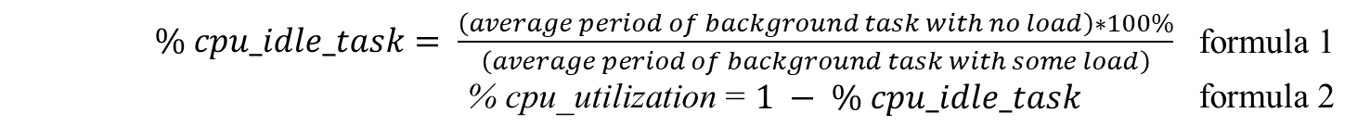
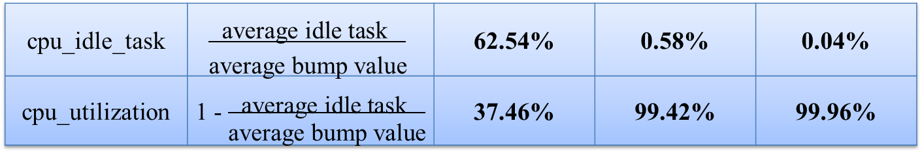
CPU Usage – Interrupt
How have you measured the CPU utilization? -- Bump switch CPU utilization
We define CPU utilization, as the amount of time not in the idle task, as shown in below formula 1 & 2.
$\% cpu_idle_task= \frac{\left(average period of background task with no load\right)∗100\%}{\left(average period of background task with some load\right)}$ formula 1
% cpu_utilization = $1 − \% cpu_idle_task$ formula 2
Interrupt (_no_operation) | MODE | MODE_DEFAULT (cunit: lock cycle) | MODE_SW1 (cunit: lock cycle) | MODE_SW2 (cunit: lock cycle)
 | average idle task | 217 | 276950 | 46513
 | average bump value | 347 | 48008510 | 112838110
cpu_idle_task | $$\frac{\text{average} \text{idle} \text{task} }{\text{average} \text{bump} \text{value}}$$ | 62.54% | 0.58% | 0.04%
cpu_utilization | 1 - $\frac{\text{average} \text{idle} \text{task} }{\text{average} \text{bump} \text{value}}$ | 37.46% | 99.42% | 99.96%
reference@: https://www.embedded.com/how-to-calculate-cpu-utilization/

Slide 19

CPU Usage – Interrupt
How have you measured the CPU utilization? -- model exchange CPU utilization
We could know the formula 3 from formula 1 & 2.
$\% cpu_utilization= \frac{\left(average period of background task with interrupt\right)∗100\%}{\left(average period of background task with some load\right)}$ formula 3
Model exchange | Exchange Average Time | Interrupt Average Time | CPU utilization
mode0 to mode1 | 48285102 | 48008152 | 99.43%
mode0 to mode2 | 48054667 | 48008154 | 99.90%
mode1 to mode1 | 276950 | 0 | 0.00%
mode1 to mode2 | 48054781 | 48008268 | 99.90%
mode2 to mode1 | 48285102 | 48008152 | 99.43%
mode2 to mode2 | 46513 | 0 | 0.00%
reference@: https://www.embedded.com/how-to-calculate-cpu-utilization/

Slide 20
CPU Usage – Polling
How have you measured the CPU utilization?
We think it is unnecessary to calculate the CPU utilization in the polling model. Because during this model, we did not use any loads (interrupts).
Result: Longer response time for request in pooling mdoe compared to interrupt mdoe
Polling (_no_operation) | MODE | MODE_DEFAULT (cunit: lock cycle) | MODE_SW1 (cunit: lock cycle) | MODE_SW2 (cunit: lock cycle)
 | average idle task | - | 276885 | 46453
1 | bump1 | - | 48285103 | 108234885
 | bump2 | - | 48285103 | 112838083
 | bump3 | - | 48285103 | 117441277
 | bump4 | - | 48285103 | 117441266
 | bump5 | - | 48285103 | 112838053
 | bump6 | - | 48285103 | 108234843
 | average bump value | - | 48285103 | 112838067

Slide 21
Questions: 1. As we all know, interrupt has the highest priority, but when interrupt processing task is time-consuming, if the main polling meets other related data processing or communication task, it cannot be processed effectively. What should we deal with this? 2. Does shortening interrupt time mean putting some time-consuming blocking tasks in the main polling? If we put it in the main polling, we will still have the same problems as the above question because we can't do fast polling. How should this be handled? Timer / Queue (Time queue and task queue to support the main polling) / Other kind of units in this controller / Use the system (FreeRtos) ?

Slide 22
Thank you for your listening!

